Slide 1
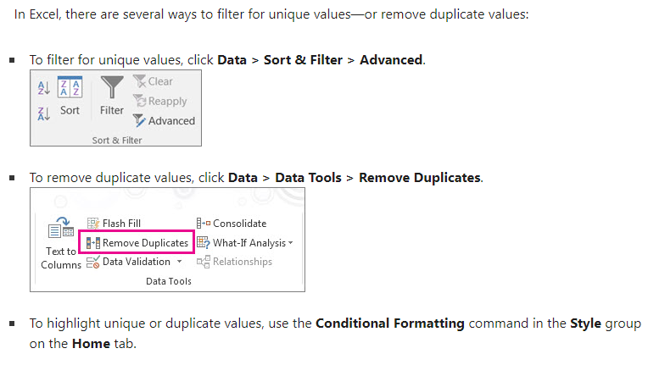
Method : 1

Slide 2
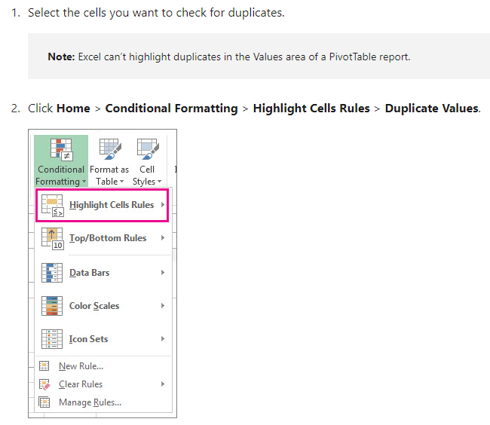

Method : 2

Slide 3
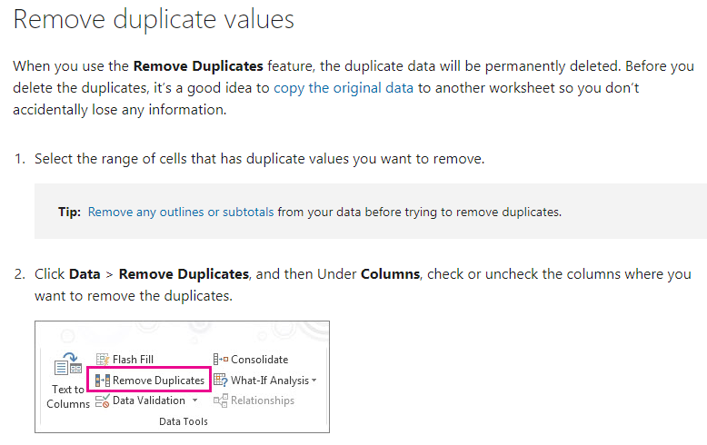

Slide 4
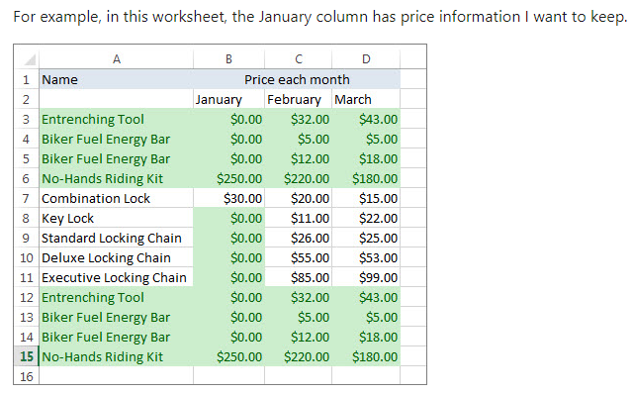
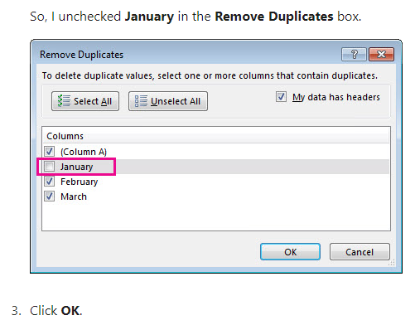

Slide 5
https://www.simplilearn.com/tutorials/excel-tutorial/remove-excel-duplicate

